Slide 1
The Foundations: Logic and Proofs
Chapter 1, Part I: Propositional Logic
With Question/Answer Animations
© 2019 McGraw-Hill Education. All rights reserved. Authorized only for instructor use in the classroom. No reproduction or further distribution permitted without the prior written consent of McGraw-Hill Education.

Slide 2
Chapter Summary
Propositional Logic
The Language of Propositions
Applications
Logical Equivalences
Predicate Logic
The Language of Quantifiers
Logical Equivalences
Nested Quantifiers
Proofs
Rules of Inference
Proof Methods
Proof Strategy

Slide 3
Propositional Logic Summary
The Language of Propositions
Connectives
Truth Values
Truth Tables
Applications
Translating English Sentences
System Specifications
Logic Puzzles
Logic Circuits
Logical Equivalences
Important Equivalences
Showing Equivalence
Satisfiability

Slide 4
Propositional Logic
Section 1.1

Slide 5
Section Summary 1
Propositions
Connectives
Negation
Conjunction
Disjunction
Implication; contrapositive, inverse, converse
Biconditional
Truth Tables

Slide 6
Propositions
A proposition is a declarative sentence that is either true or false.
Examples of propositions:
The Moon is made of green cheese.
Trenton is the capital of New Jersey.
Toronto is the capital of Canada.
1 + 0 = 1
0 + 0 = 2
Examples that are not propositions.
Sit down!
What time is it?
x + 1 = 2
x + y = z

Slide 7
Propositional Logic
Constructing Propositions
Propositional Variables: p, q, r, s, …
The proposition that is always true is denoted by T and the proposition that is always false is denoted by F.
Compound Propositions; constructed from logical connectives and other propositions
Negation ¬
Conjunction ∧
Disjunction ∨
Implication →
Biconditional ↔

Slide 8
Compound Propositions: Negation
The negation of a proposition p is denoted by ¬p and has this truth table:
p | ¬p
T | F
F | T
Example: If p denotes “The earth is round.”, then ¬p denotes “It is not the case that the earth is round,” or more simply “The earth is not round.”

Slide 9
Conjunction
The conjunction of propositions p and q is denoted by p ∧ q and has this truth table:
p | q | P ∧ q
T | T | T
T | F | F
F | T | F
F | F | F
Example: If p denotes “I am at home.” and q denotes “It is raining.” then p ∧ q denotes “I am at home and it is raining.”

Slide 10
Disjunction
The disjunction of propositions p and q is denoted by p ∨ q and has this truth table:
p | q | P ∨ q
T | T | T
T | F | T
F | T | T
F | F | F
Example: If p denotes “I am at home.” and q denotes “It is raining.” then p ∨ q denotes “I am at home or it is raining.”

Slide 11
The Connective Or in English
In English “or” has two distinct meanings.
“Inclusive Or” - In the sentence “Students who have taken CS202 or Math120 may take this class,” we assume that students need to have taken one of the prerequisites, but may have taken both. This is the meaning of disjunction. For p ∨ q to be true, either one or both of p and q must be true.
“Exclusive Or” - When reading the sentence “Soup or salad comes with this entrée,” we do not expect to be able to get both soup and salad. This is the meaning of Exclusive Or (Xor). In p ⊕ q , one of p and q must be true, but not both. The truth table for ⊕ is:
p | q | P ⊕ q
T | T | F
T | F | T
F | T | T
F | F | F

Slide 12
Implication
If p and q are propositions, then p → q is a conditional statement or implication which is read as “if p, then q” and has this truth table:
p | q | P → q
T | T | T
T | F | F
F | T | T
F | F | T
Example: If p denotes “I am at home.” and q denotes “It is raining.” then p → q denotes “If I am at home then it is raining.”
In p → q, p is the hypothesis (antecedent or premise) and q is the conclusion (or consequence).

Slide 13
Understanding Implication 1
In p → q there does not need to be any connection between the antecedent or the consequent. The “meaning” of p → q depends only on the truth values of p and q.
These implications are perfectly fine, but would not be used in ordinary English.
“If the moon is made of green cheese, then I have more money than Bill Gates. ”
“If the moon is made of green cheese then I’m on welfare.”
“If 1 + 1 = 3, then your grandma wears combat boots.”

Slide 14
Understanding Implication 2
One way to view the logical conditional is to think of an obligation or contract.
“If I am elected, then I will lower taxes.”
“If you get 100% on the final, then you will get an A.”
If the politician is elected and does not lower taxes, then the voters can say that he or she has broken the campaign pledge. Something similar holds for the professor. This corresponds to the case where p is true and q is false.

Slide 15
Different Ways of Expressing p → q
if p, then q
if p, q
q unless ¬p
q if p
q whenever p
q follows from p
p implies q
p only if q
q when p
p is sufficient for q
q is necessary for p
a necessary condition for p is q
a sufficient condition for q is p

Slide 16
Converse, Contrapositive, and Inverse
From p → q we can form new conditional statements .
q → p is the converse of p → q
¬q → ¬p is the contrapositive of p → q
¬p → ¬q is the inverse of p → q
Example: Find the converse, inverse, and contrapositive of “It raining is a sufficient condition for my not going to town.”
Solution:
converse: If I do not go to town, then it is raining.
inverse: If it is not raining, then I will go to town.
contrapositive: If I go to town, then it is not raining.

Slide 17
Biconditional
If p and q are propositions, then we can form the biconditional proposition p ↔ q, read as “p if and only if q .” The biconditional p ↔ q denotes the proposition with this truth table:
p | q | P ↔ q
T | T | T
T | F | F
F | T | F
F | F | T
If p denotes “I am at home.” and q denotes “It is raining.” then p ↔ q denotes “I am at home if and only if it is raining.”

Slide 18
Expressing the Biconditional
Some alternative ways “p if and only if q” is expressed in English:
p is necessary and sufficient for q
if p then q, and conversely
p if q

Slide 19
Truth Tables For Compound Propositions
Construction of a truth table:
Rows
Need a row for every possible combination of values for the atomic propositions.
Columns
Need a column for the compound proposition (usually at far right)
Need a column for the truth value of each expression that occurs in the compound proposition as it is built up.
This includes the atomic propositions

Slide 20
Example Truth Table
Construct a truth table for p ∨ q → ¬r
p | q | r | ¬r | p ∨ q | p ∨ q → ¬r
T | T | T | F | T | F
T | T | F | T | T | T
T | F | T | F | T | F
T | F | F | T | T | T
F | T | T | F | T | F
F | T | F | T | T | T
F | F | T | F | F | T
F | F | F | T | F | T

Slide 21
Equivalent Propositions
Two propositions are equivalent if they always have the same truth value.
Example: Show using a truth table that the conditional is equivalent to the contrapositive.
Solution:
p | q | ¬p | ¬q | p → q | ¬q → ¬p
T | T | F | F | T | T
T | F | F | T | F | F
F | T | T | F | T | T
F | F | T | T | T | T

Slide 22
Using a Truth Table to Show Non-Equivalence
Example: Show using truth tables that neither the converse nor inverse of an implication are not equivalent to the implication.
Solution:
p | q | ¬p | ¬q | p → q | ¬p → ¬q | q → p
T | T | F | F | T | T | T
T | F | F | T | F | T | T
F | T | T | F | T | F | F
F | F | T | T | T | T | T

Slide 23
Problem
How many rows are there in a truth table with n propositional variables?
Solution: 2^{n} We will see how to do this in Chapter 6.
Note that this means that with n propositional variables, we can construct 2^{n} distinct (that is, not equivalent) propositions.

Slide 24
Precedence of Logical Operators
Operator | Precedence
¬ | 1
∧ | 2
∨ | 3
→ | 4
↔ | 5
p ∨ q → ¬r is equivalent to (p ∨ q) → ¬r
If the intended meaning is p ∨(q → ¬r)
then parentheses must be used.

Slide 25
Applications of Propositional Logic
Section 1.2

Slide 26
Applications of Propositional Logic: Summary
Translating English to Propositional Logic
System Specifications
Boolean Searching
Logic Puzzles
Logic Circuits
AI Diagnosis Method (Optional)

Slide 27
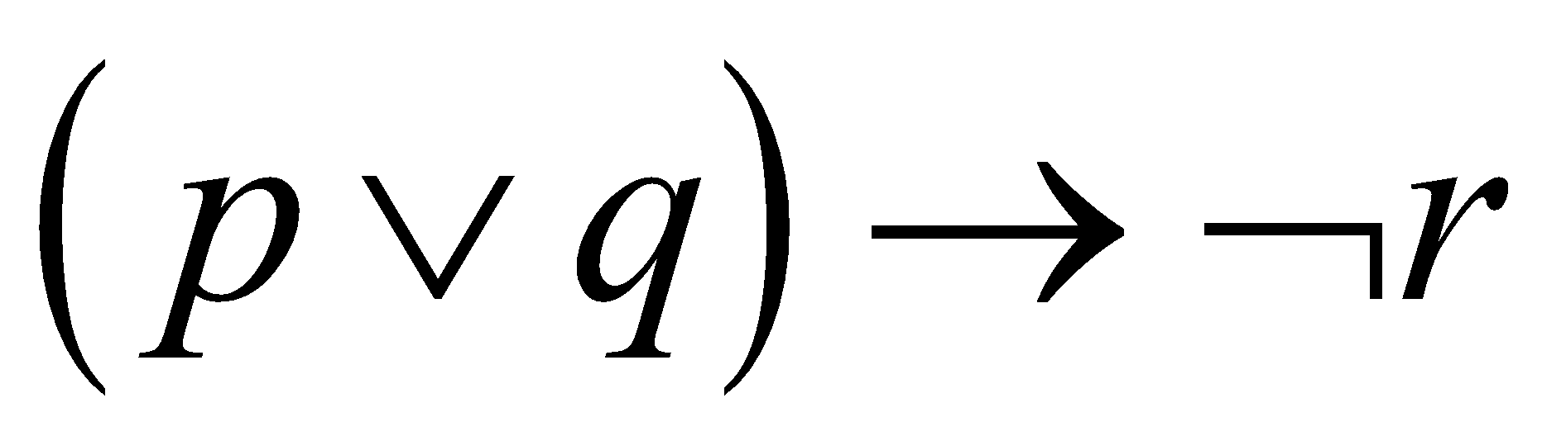
Translating English Sentences
Steps to convert an English sentence to a statement in propositional logic
Identify atomic propositions and represent using propositional variables.
Determine appropriate logical connectives
“If I go to Harry’s or to the country, I will not go shopping.”
p: I go to Harry’s
q: I go to the country.
r: I will go shopping.
If p or q then not r.

Slide 28
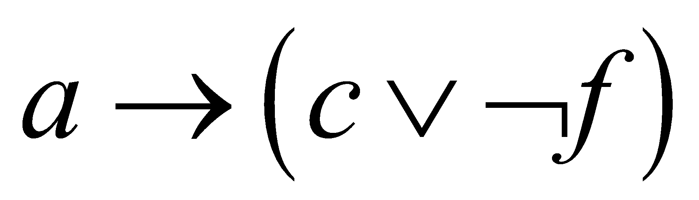
Example
Problem: Translate the following sentence into propositional logic:
“You can access the Internet from campus only if you are a computer science major or you are not a freshman.”
One Solution: Let a, c, and f represent respectively “You can access the internet from campus,” “You are a computer science major,” and “You are a freshman.”

Slide 29
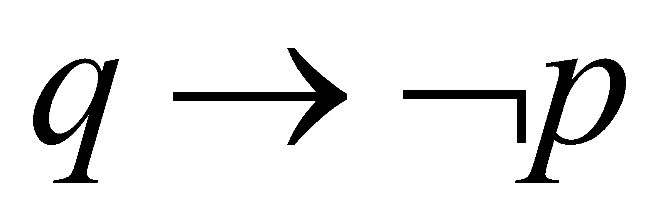
System Specifications
System and Software engineers take requirements in English and express them in a precise specification language based on logic.
Example: Express in propositional logic:
“The automated reply cannot be sent when the file system is full”
Solution: One possible solution: Let p denote “The automated reply can be sent” and q denote “The file system is full.”

Slide 30
Consistent System Specifications
Definition: A list of propositions is consistent if it is possible to assign truth values to the proposition variables so that each proposition is true.
Exercise: Are these specifications consistent?
“The diagnostic message is stored in the buffer or it is retransmitted.”
“The diagnostic message is stored in the buffer.”
“If the diagnostic message is stored in the buffer, then it is retransmitted.”
Solution: Let p denote “The diagnostic message is stored in the buffer.” Let q denote “The diagnostic message is retransmitted” The specification can be written as: p ∨ q, ¬p, p → q. When p is false and q is true all three statements are true. So the specification is consistent.
What if “The diagnostic message is not retransmitted” is added.
Solution: Now we are adding ¬q and there is no satisfying assignment. So the specification is not consistent.

Slide 31
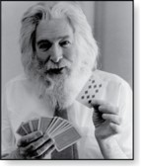
Logic Puzzles
Raymond Smullyan (Born 1919)
An island has two kinds of inhabitants, knights, who always tell the truth, and knaves, who always lie.
You go to the island and meet A and B.
A says “B is a knight.”
B says “The two of us are of opposite types.”
Example: What are the types of A and B?
Solution: Let p and q be the statements that A is a knight and B is a knight, respectively. So, then ¬p represents the proposition that A is a knave and ¬q that B is a knave.
If A is a knight, then p is true. Since knights tell the truth, q must also be true. Then (p ∧ ¬ q) ∨ (¬ p ∧ q) would have to be true, but it is not. So, A is not a knight and therefore ¬p must be true.
If A is a knave, then B must not be a knight since knaves always lie. So, then both ¬p and ¬q hold since both are knaves.

Slide 32

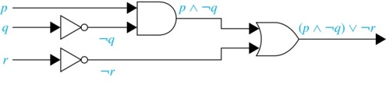
Logic Circuits (Studied in depth in Chapter 12)
Electronic circuits; each input/output signal can be viewed as a 0 or 1.
0 represents False
1 represents True
Complicated circuits are constructed from three basic circuits called gates.
The inverter (NOT gate)takes an input bit and produces the negation of that bit.
The OR gate takes two input bits and produces the value equivalent to the disjunction of the two bits.
The AND gate takes two input bits and produces the value equivalent to the conjunction of the two bits.
More complicated digital circuits can be constructed by combining these basic circuits to produce the desired output given the input signals by building a circuit for each piece of the output expression and then combining them. For example:

Slide 33
Diagnosis of Faults in an Electrical System (Optional)
AI Example (from Artificial Intelligence: Foundations of Computational Agents by David Poole and Alan Mackworth, 2010)
Need to represent in propositional logic the features of a piece of machinery or circuitry that are required for the operation to produce observable features. This is called the Knowledge Base (KB).
We also have observations representing the features that the system is exhibiting now.

Slide 34
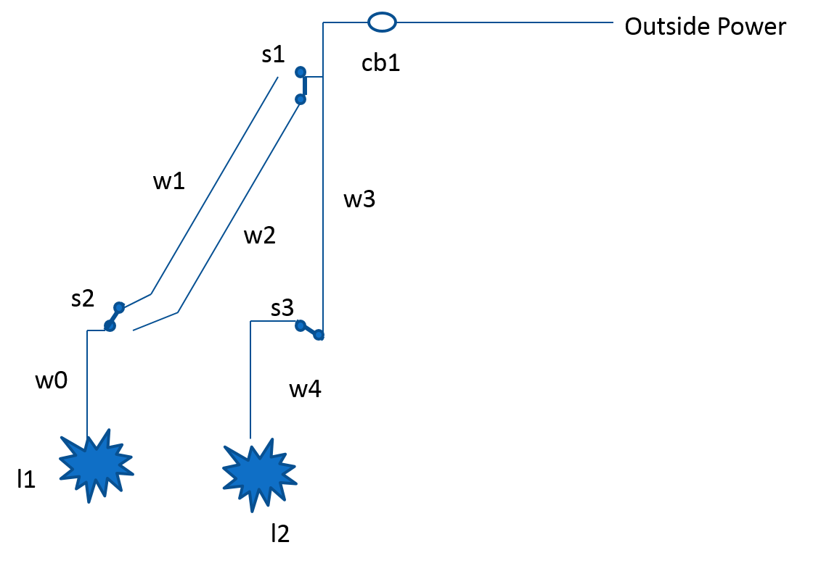
Electrical System Diagram (optional)
Have lights (l1, l2), wires (w0, w1, w2, w3, w4), switches (s1, s2, s3), and circuit breakers (cb1)
The next page gives the knowledge base describing the circuit and the current observations.

Slide 35
Representing the Electrical System in Propositional Logic
We need to represent our common-sense understanding of how the electrical system works in propositional logic.
For example: “If l1 is a light and if l1 is receiving current, then l1 is lit.
light_l1 ∧ live_l1 ∧ ok_l1 → lit_l1
Also: “If w1 has current, and switch s2 is in the up position, and s2 is not broken, then w0 has current.”
live_w1 ∧ up_s2 ∧ ok_s2 → live_w0
This task of representing a piece of our common-sense world in logic is a common one in logic-based AI.

Slide 36
Knowledge Base (opt)
live_outside
light_l1
light_l2
live_w0 → live_l1
live_w1 ∧ up_s2 ∧ ok_s2 → live_w0
live_w2 ∧ down_s2 ∧ ok_s2 → live_w0
live_w3 ∧ up_s1 ∧ ok_s1 → live_w1
live_w3 ∧ down_s1 ∧ ok_s1 → live_w2
live_w4 → live_l2
live_w3 ∧ up_s3 ∧ ok_s3 → live_w4
live_outside ∧ ok_cb1 → live_w3
light_l1 ∧ live_l1 ∧ ok_l1 → lit_l1
light_l2 ∧ live_l2 ∧ ok_l2 → lit_l2
We have outside power.
Both l1 and l2 are lights.
If s2 is ok and s2 is in a down position and w2 has current, then w0 has current.

Slide 37
Observations (opt)
Observations need to be added to the KB
Both Switches up
up_s1
up_s2
Both lights are dark
¬ lit_l1
¬ lit_l2

Slide 38
Diagnosis (opt)
We assume that the components are working ok, unless we are forced to assume otherwise. These atoms are called assumables.
The assumables (ok_cb1, ok_s1, ok_s2, ok_s3, ok_l1, ok_l2) represent the assumption that we assume that the switches, lights, and circuit breakers are ok.
If the system is working correctly (all assumables are true), the observations and the knowledge base are consistent (i.e., satisfiable).
The augmented knowledge base is clearly not consistent if the assumables are all true. The switches are both up, but the lights are not lit. Some of the assumables must then be false. This is the basis for the method to diagnose possible faults in the system.
A diagnosis is a minimal set of assumables which must be false to explain the observations of the system.

Slide 39
Diagnostic Results (opt)
See Artificial Intelligence: Foundations of Computational Agents (by David Poole and Alan Mackworth, 2010) for details on this problem and how the method of consistency based diagnosis can determine possible diagnoses for the electrical system.
The approach yields 7 possible faults in the system. At least one of these must hold:
Circuit Breaker 1 is not ok.
Both Switch 1 and Switch 2 are not ok.
Both Switch 1 and Light 2 are not ok.
Both Switch 2 and Switch 3 are not ok.
Both Switch 2 and Light 2 are not ok.
Both Light 1 and Switch 3 are not ok.
Both Light 1 and Light 2 are not ok.

Slide 40
Propositional Equivalences
Section 1.3

Slide 41
Section Summary 2
Tautologies, Contradictions, and Contingencies.
Logical Equivalence
Important Logical Equivalences
Showing Logical Equivalence
Normal Forms (optional, covered in exercises in text)
Disjunctive Normal Form
Conjunctive Normal Form
Propositional Satisfiability
Sudoku Example

Slide 42
Tautologies, Contradictions, and Contingencies
A tautology is a proposition which is always true.
Example: p ∨ ¬p
A contradiction is a proposition which is always false.
Example: p ∧ ¬p
A contingency is a proposition which is neither a tautology nor a contradiction, such as p
P | ¬p | p ∨ ¬p | p ∧ ¬p
T | F | T | F
F | T | T | F

Slide 43
Logically Equivalent
Two compound propositions p and q are logically equivalent if p↔q is a tautology.
We write this as p⇔q or as p≡q where p and q are compound propositions.
Two compound propositions p and q are equivalent if and only if the columns in a truth table giving their truth values agree.
This truth table shows that ¬p ∨ q is equivalent to p → q.
p | q | ¬p | ¬p ∨ q | p → q
T | T | F | T | T
T | F | F | F | F
F | T | T | T | T
F | F | T | T | T

Slide 44
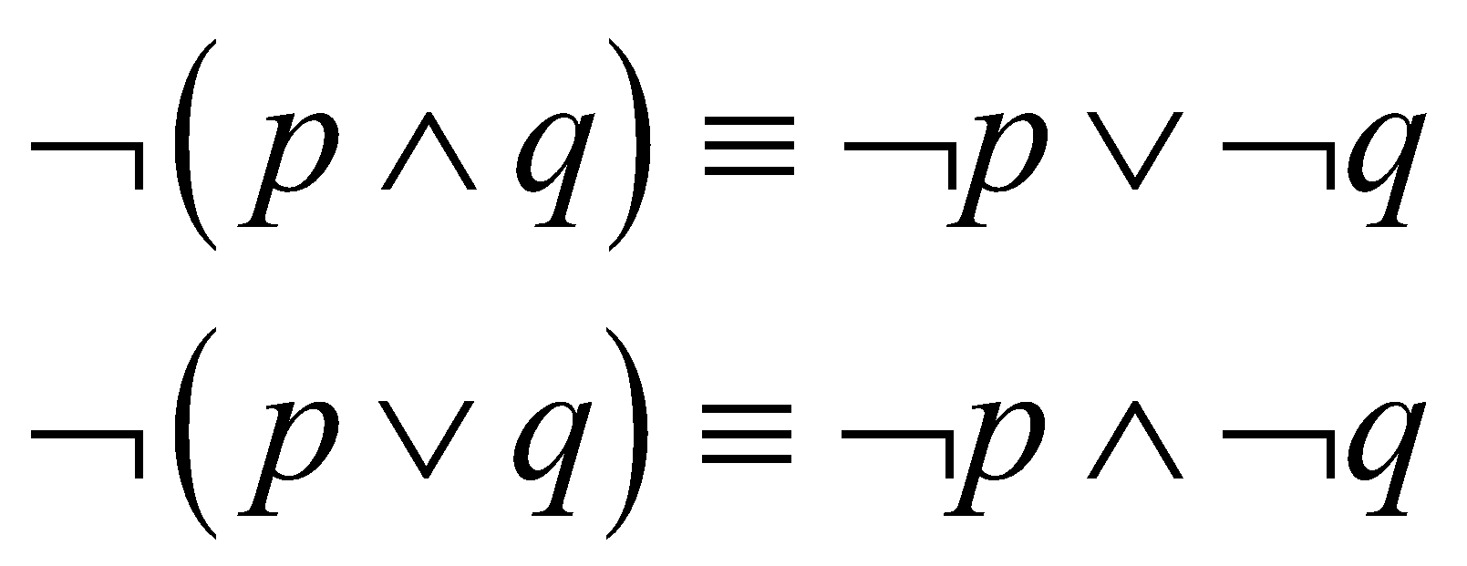
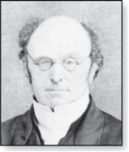
De Morgan’s Laws
Augustus De Morgan 1806-1871
This truth table shows that De Morgan’s Second Law holds.
p | q | ¬p | ¬q | (p ∨ q) | ¬(p ∨ q) | ¬p ∧ ¬q
T | T | F | F | T | F | F
T | F | F | T | T | F | F
F | T | T | F | T | F | F
F | F | T | T | F | T | T

Slide 45
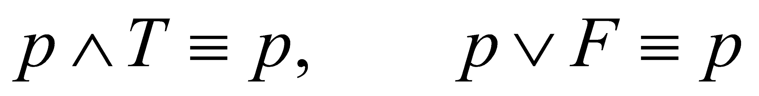
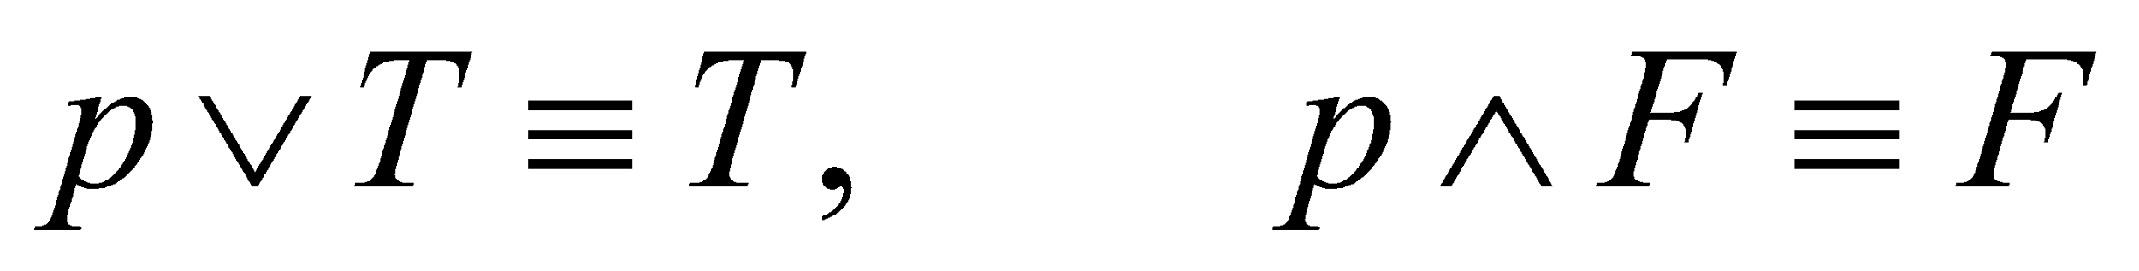
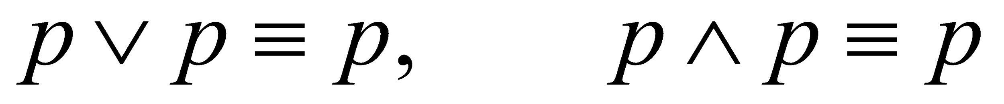
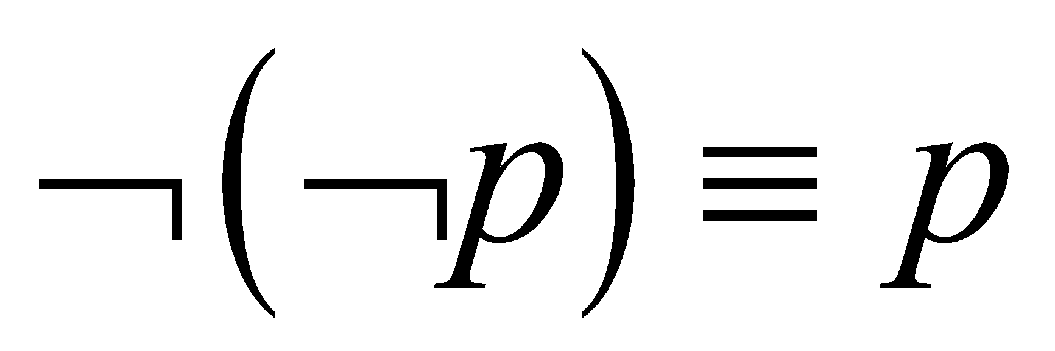
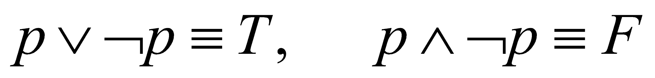
Key Logical Equivalences 1
Identity Laws:
Domination Laws:
Idempotent laws:
Double Negation Law:
Negation Laws:

Slide 46
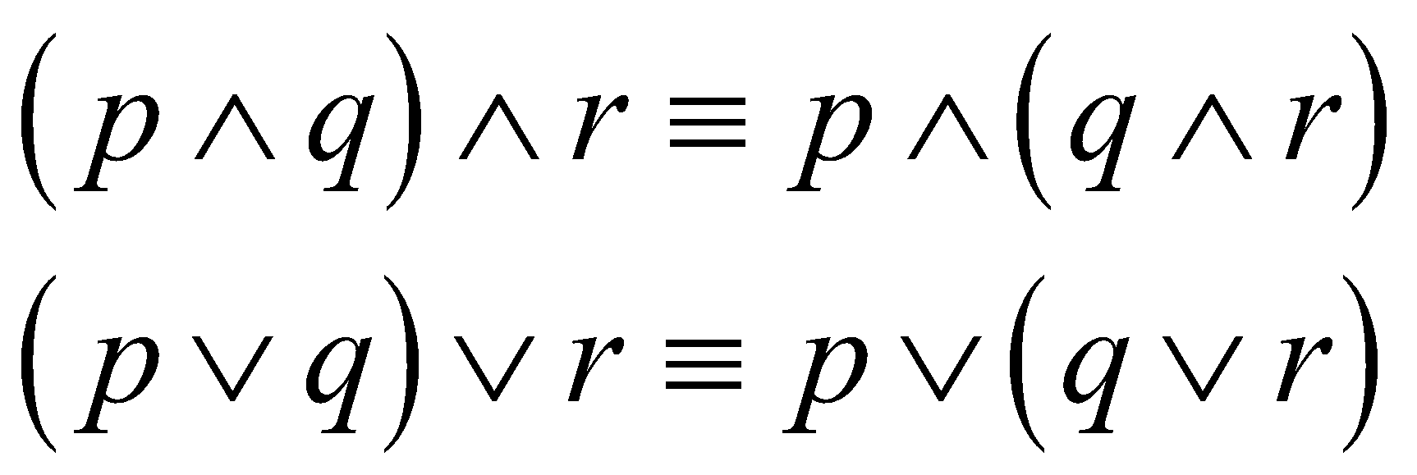
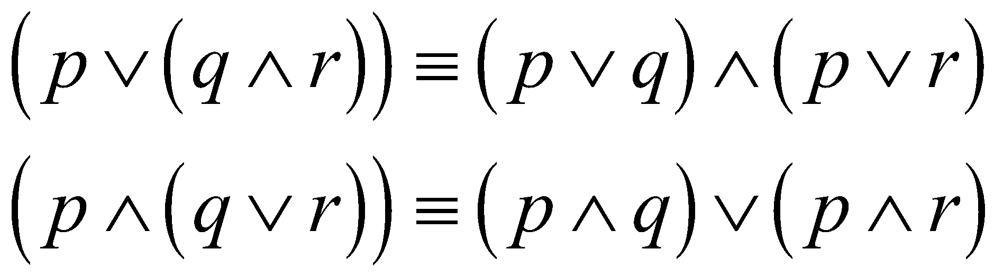
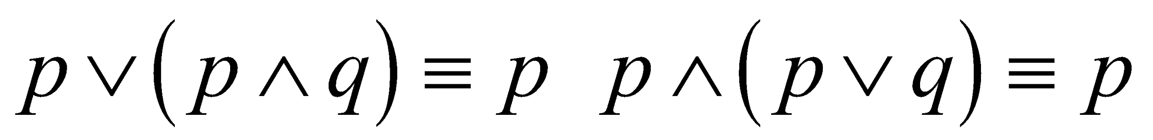
Key Logical Equivalences 2
Commutative Laws:
Associative Laws:
Distributive Laws:
Absorption Laws:

Slide 47
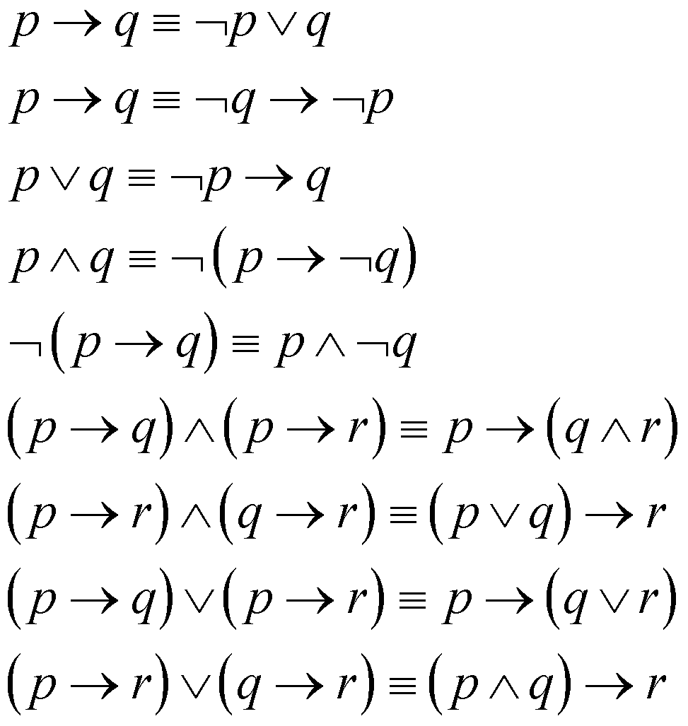
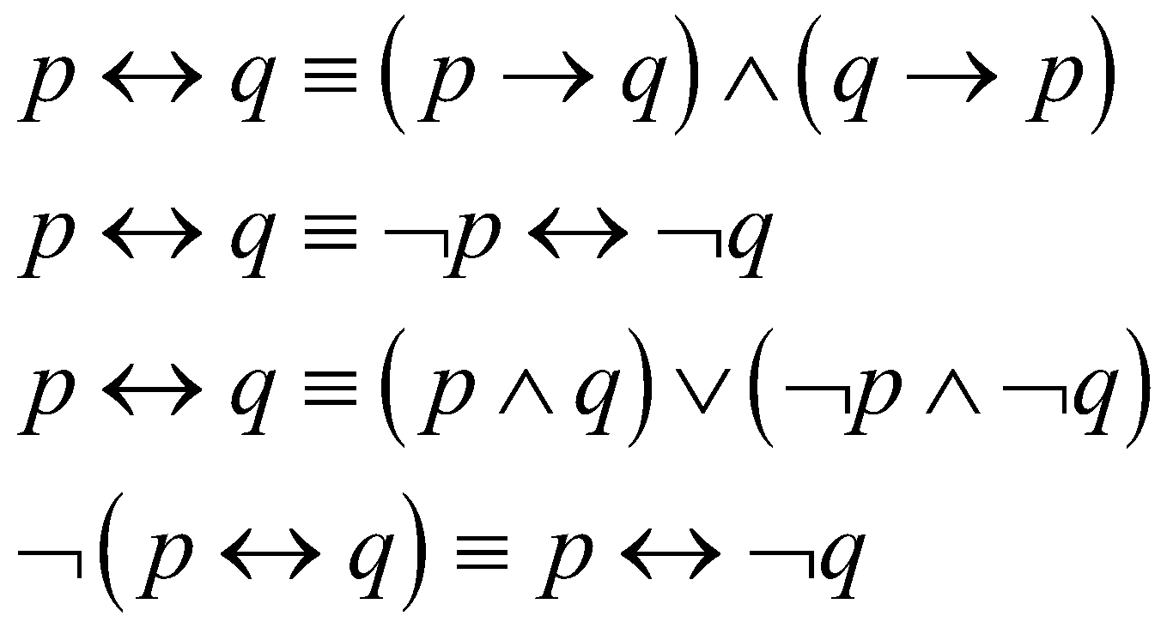
More Logical Equivalences
TABLE 7 Logical Equivalences Involving Conditional Statements.
TABLE 8 Logical Equivalences Involving Biconditional Statements.

Slide 48
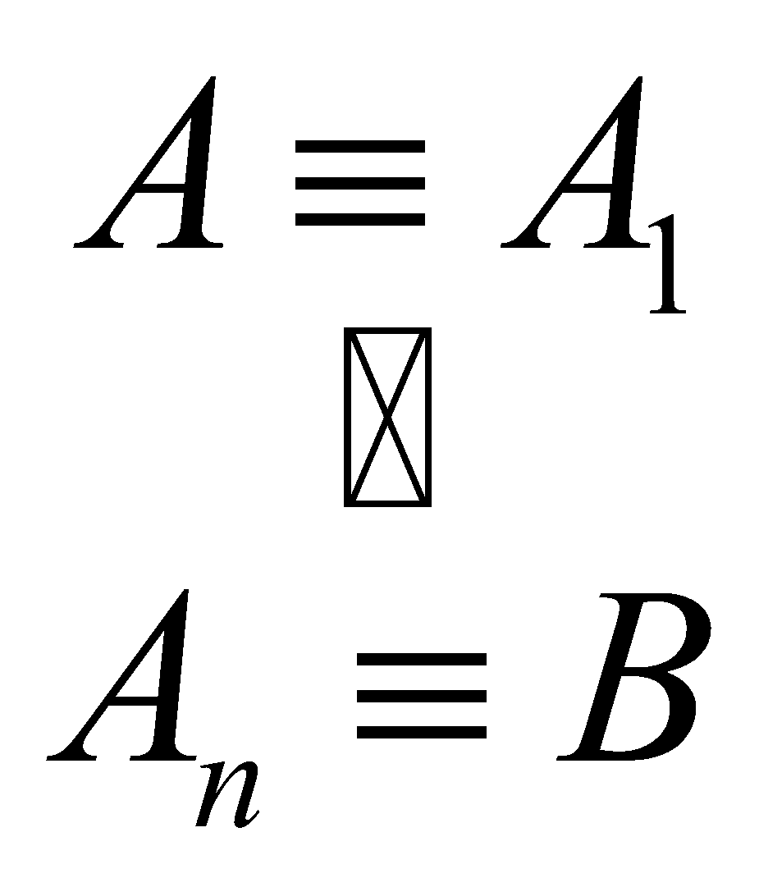
Constructing New Logical Equivalences
We can show that two expressions are logically equivalent by developing a series of logically equivalent statements.
To prove that A ≡ B we produce a series of equivalences beginning with A and ending with B.
Keep in mind that whenever a proposition (represented by a propositional variable) occurs in the equivalences listed earlier, it may be replaced by an arbitrarily complex compound proposition.

Slide 49
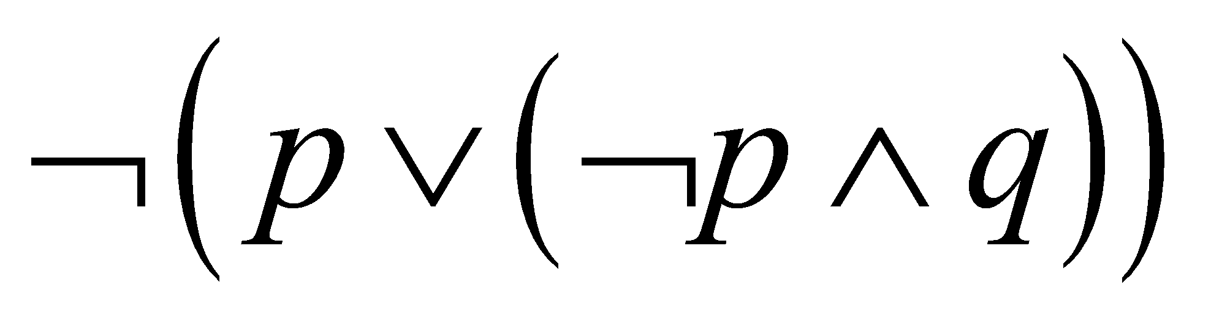
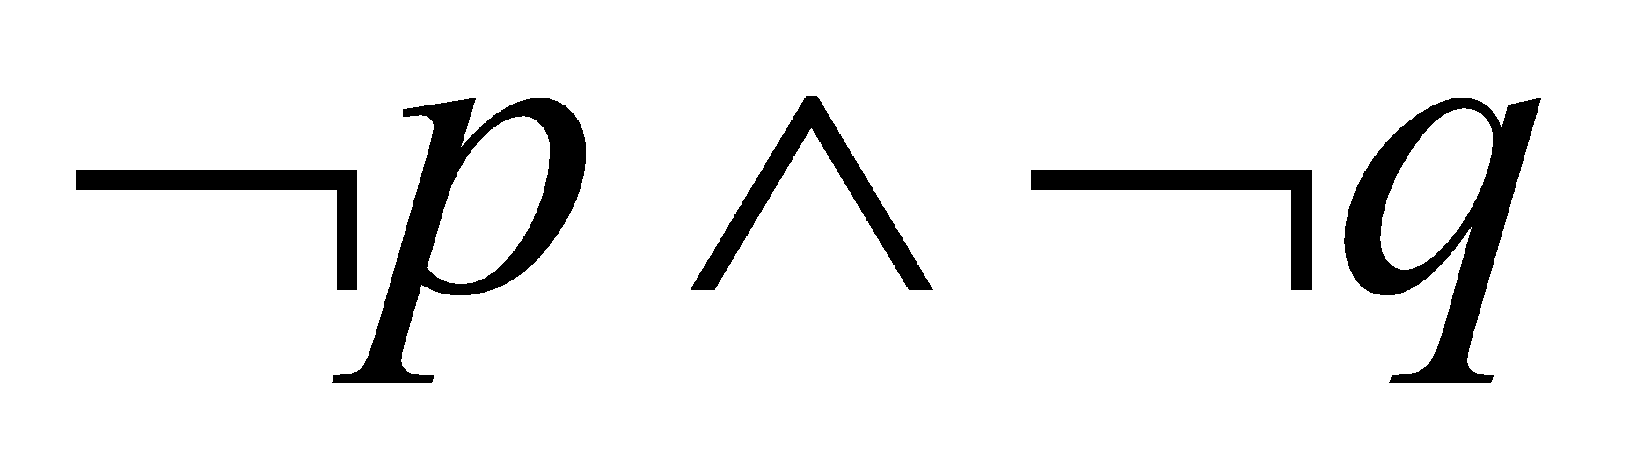
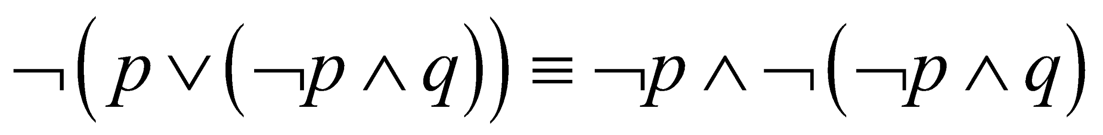
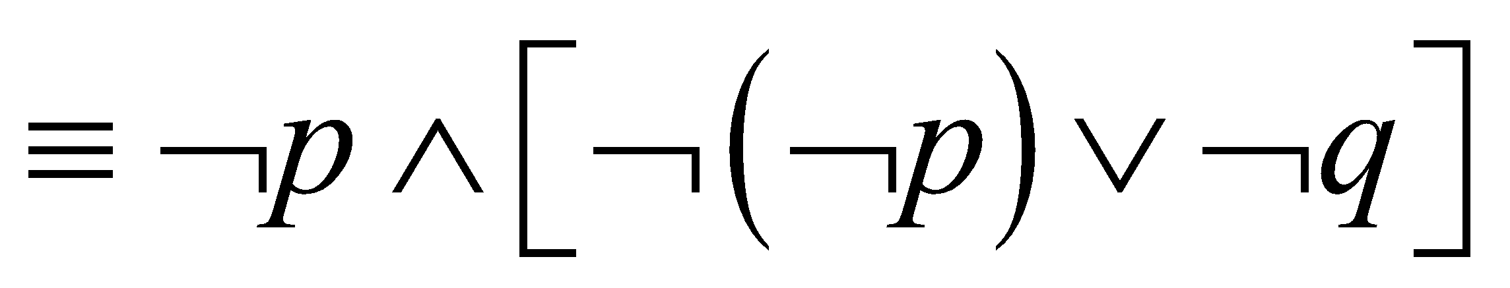
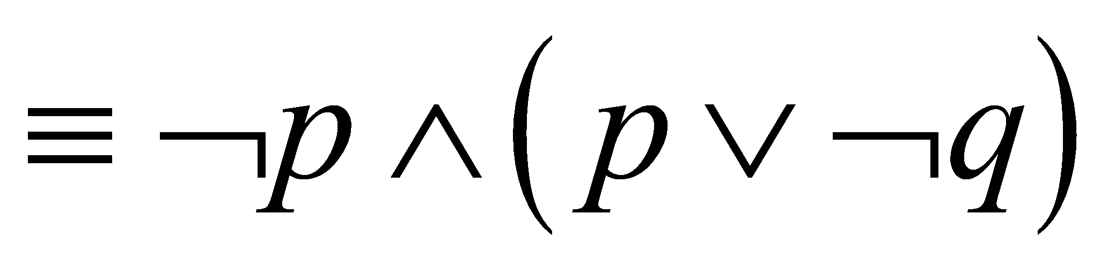
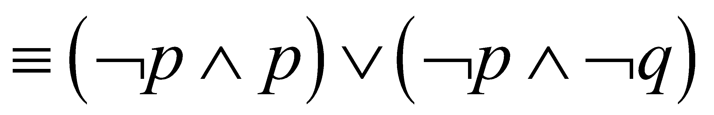
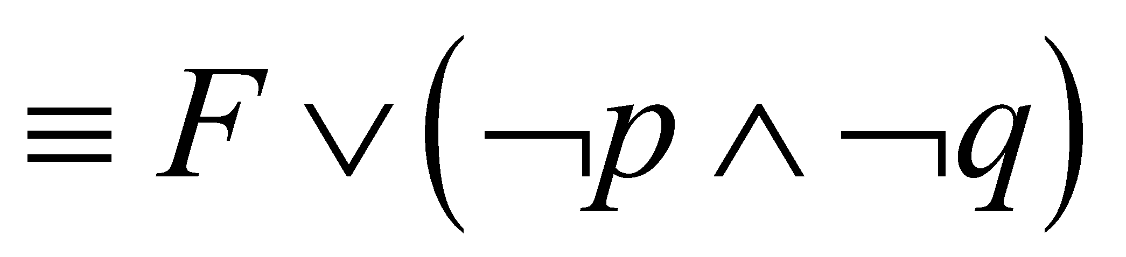
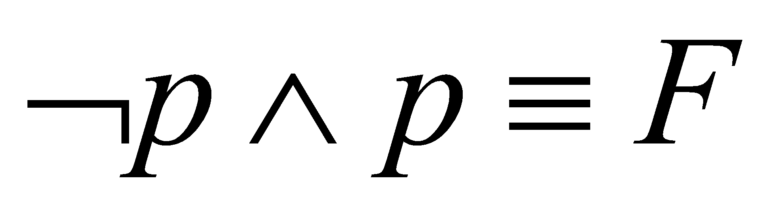
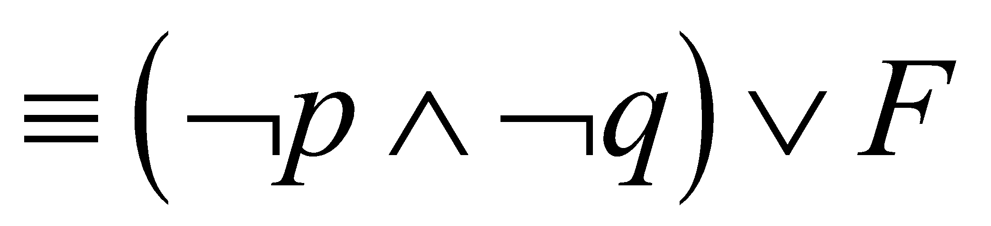
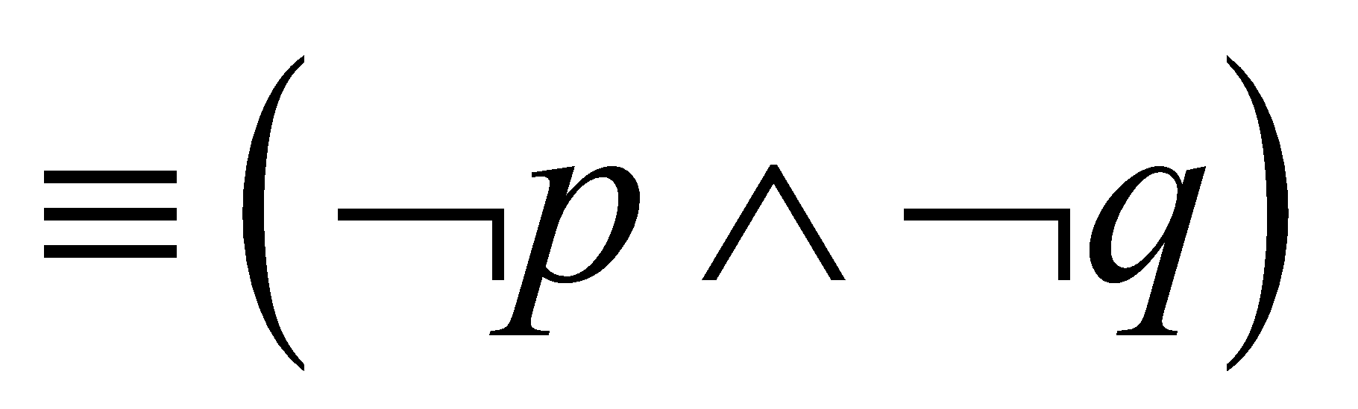
Equivalence Proofs 1
Example: Show that
is logically equivalent to
Solution:
by the second De Morgan law
by the first De Morgan law
by the double negation law
by the second distributive law
because
by the commutative law for disjunction
By the identity law for F

Slide 50
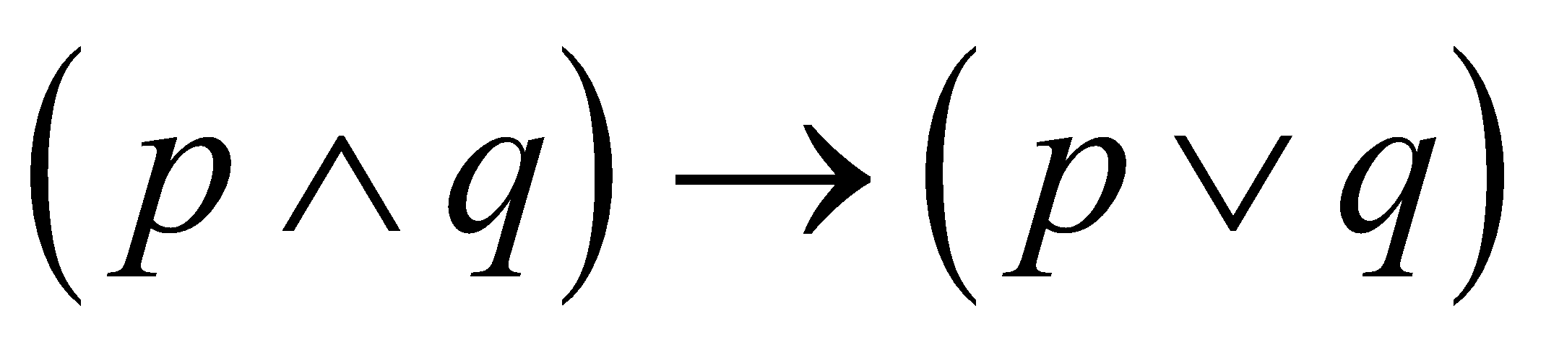
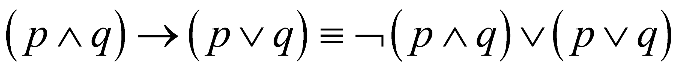
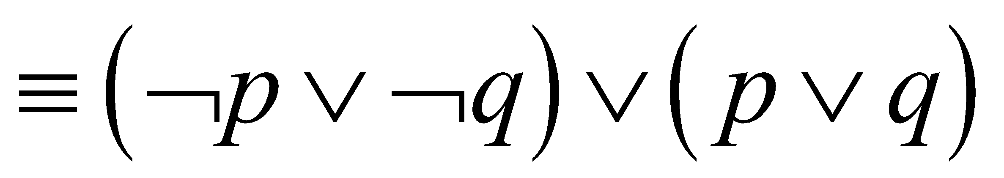
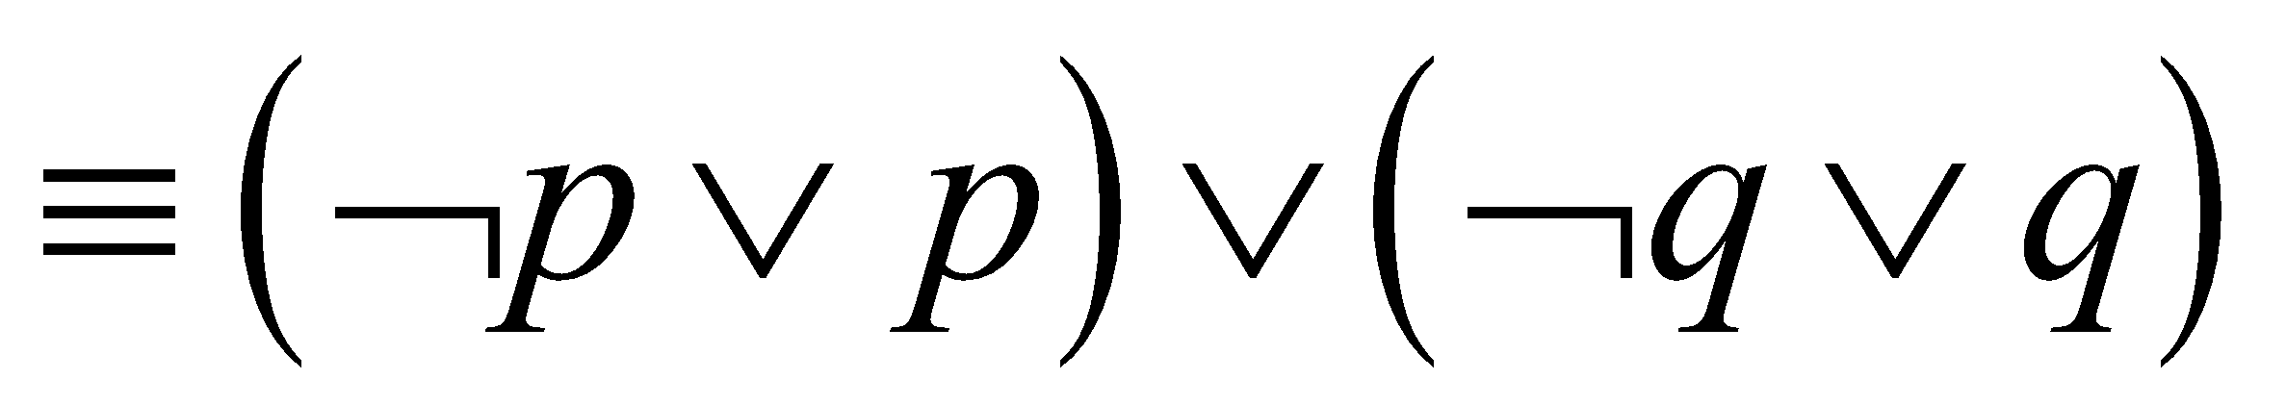


Equivalence Proofs 2
Example: Show that
is a tautology.
Solution:
by truth table for →
by the first De Morgan law
by associative and commutative laws laws for disjunction
by truth tables
by the domination law

Slide 51
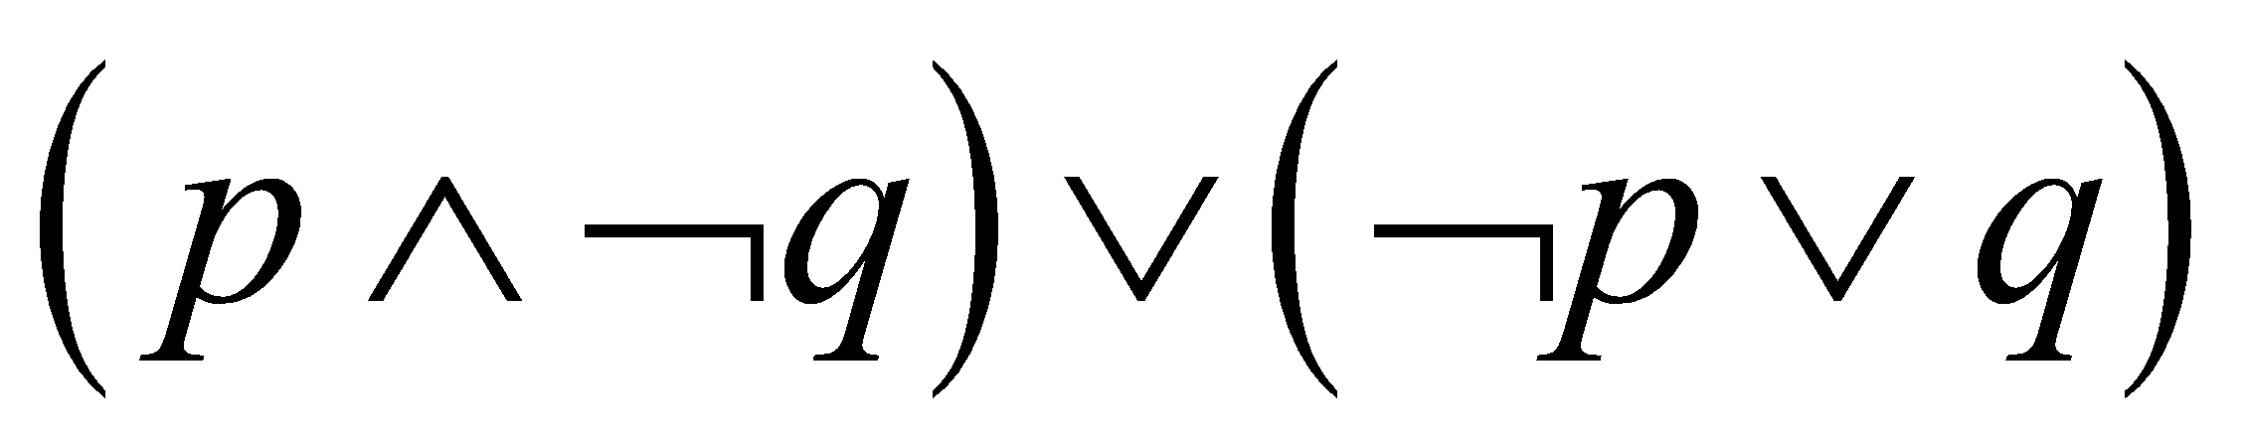
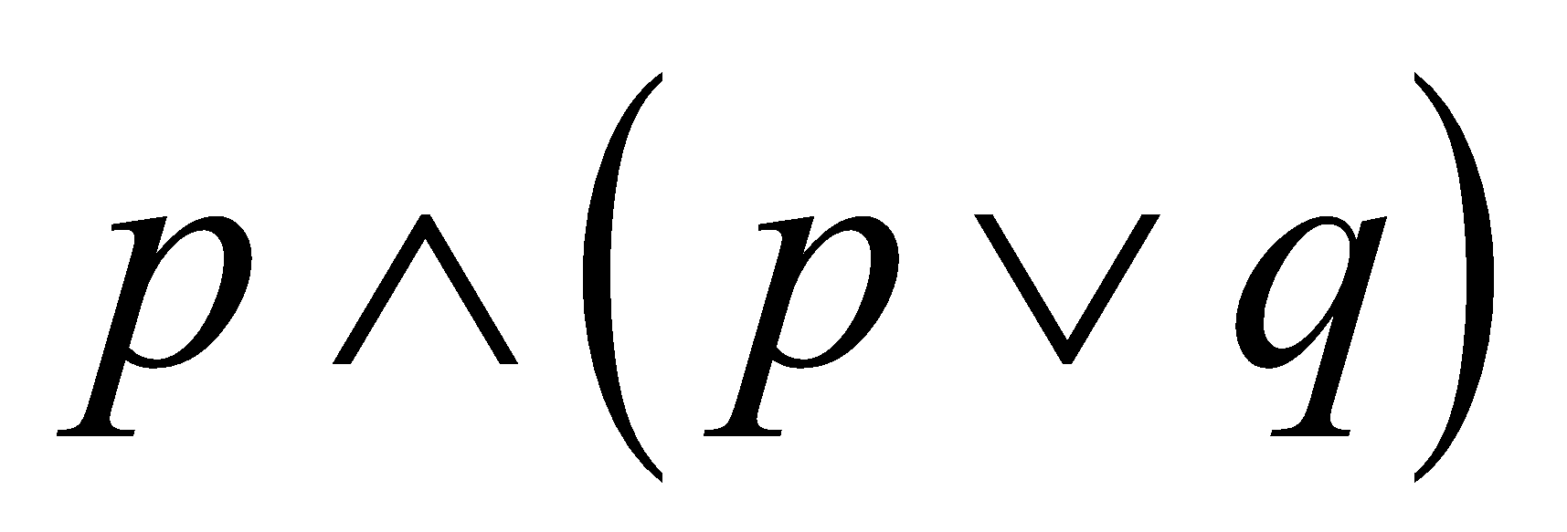
Disjunctive Normal Form (optional) 1
A propositional formula is in disjunctive normal form if it consists of a disjunction of (1, … ,n) disjuncts where each disjunct consists of a conjunction of (1, …, m) atomic formulas or the negation of an atomic formula.
Yes
No
Disjunctive Normal Form is important for the circuit design methods discussed in Chapter 12.

Slide 52
Disjunctive Normal Form (optional) 2
Example: Show that every compound proposition can be put in disjunctive normal form.
Solution: Construct the truth table for the proposition. Then an equivalent proposition is the disjunction with n disjuncts (where n is the number of rows for which the formula evaluates to T). Each disjunct has m conjuncts where m is the number of distinct propositional variables. Each conjunct includes the positive form of the propositional variable if the variable is assigned T in that row and the negated form if the variable is assigned F in that row. This proposition is in disjunctive normal from.

Slide 53
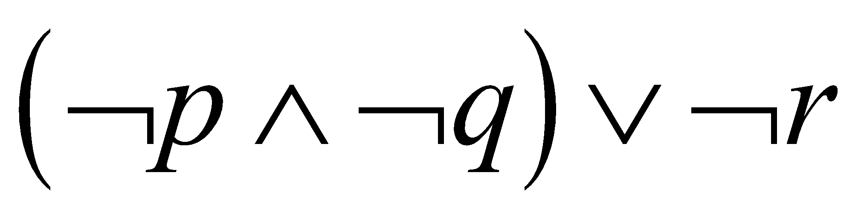
Disjunctive Normal Form (optional) 3
Example: Find the Disjunctive Normal Form (DNF) of
Solution: This proposition is true when r is false or when both p and q are false.

Slide 54
Conjunctive Normal Form (optional) 1
A compound proposition is in Conjunctive Normal Form (CNF) if it is a conjunction of disjunctions.
Every proposition can be put in an equivalent CNF.
Conjunctive Normal Form (CNF) can be obtained by eliminating implications, moving negation inwards and using the distributive and associative laws.
Important in resolution theorem proving used in artificial Intelligence (AI).
A compound proposition can be put in conjunctive normal form through repeated application of the logical equivalences covered earlier.

Slide 55
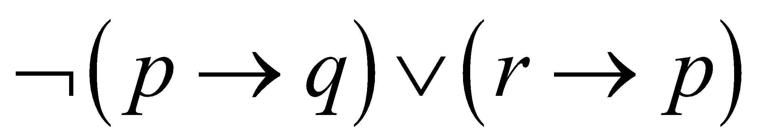
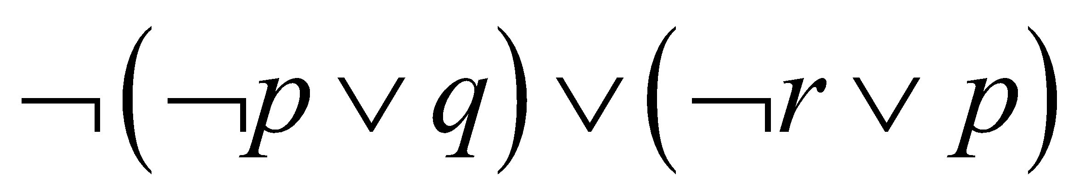
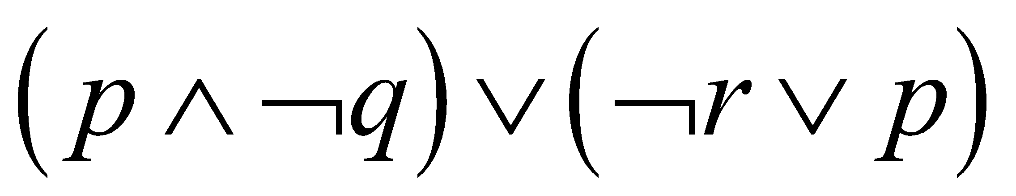
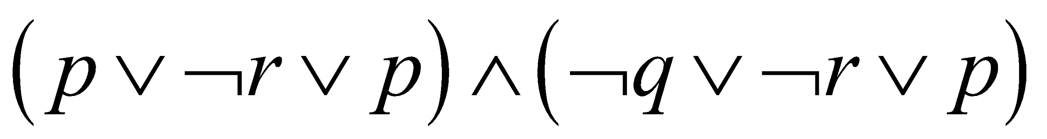
Conjunctive Normal Form (optional) 2
Example: Put the following into CNF:
Solution:
Eliminate implication signs:
Move negation inwards; eliminate double negation:
Convert to CNF using associative/distributive laws

Slide 56
Propositional Satisfiability
A compound proposition is satisfiable if there is an assignment of truth values to its variables that make it true. When no such assignments exist, the compound proposition is unsatisfiable.
A compound proposition is unsatisfiable if and only if its negation is a tautology.

Slide 57
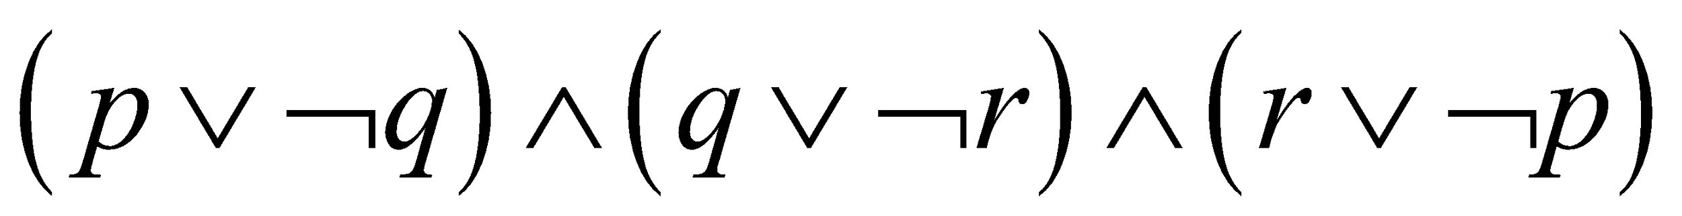
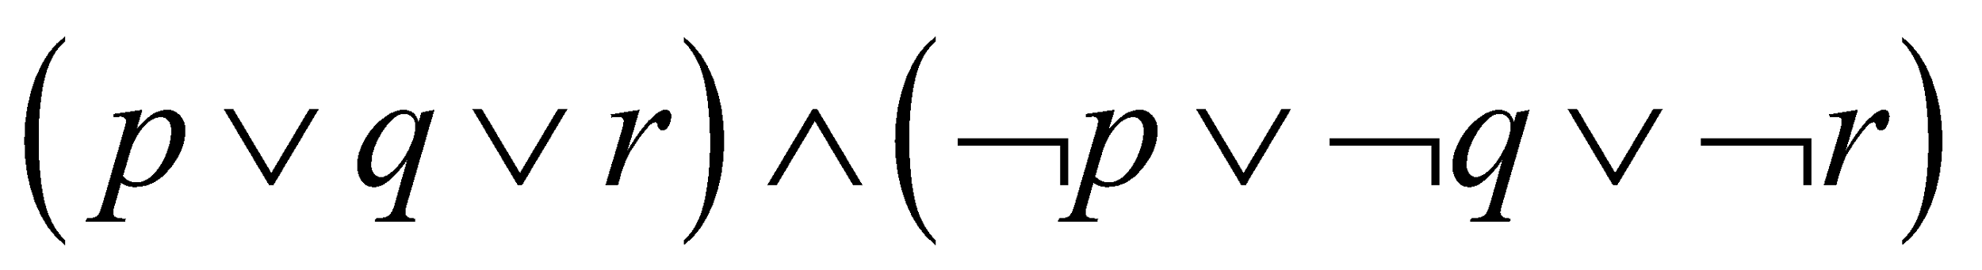
Questions on Propositional Satisfiability
Example: Determine the satisfiability of the following compound propositions:
Solution: Satisfiable. Assign T to p, q, and r.
Solution: Satisfiable. Assign T to p and F to q.
Solution: Not satisfiable. Check each possible assignment of truth values to the propositional variables and none will make the proposition true.

Slide 58
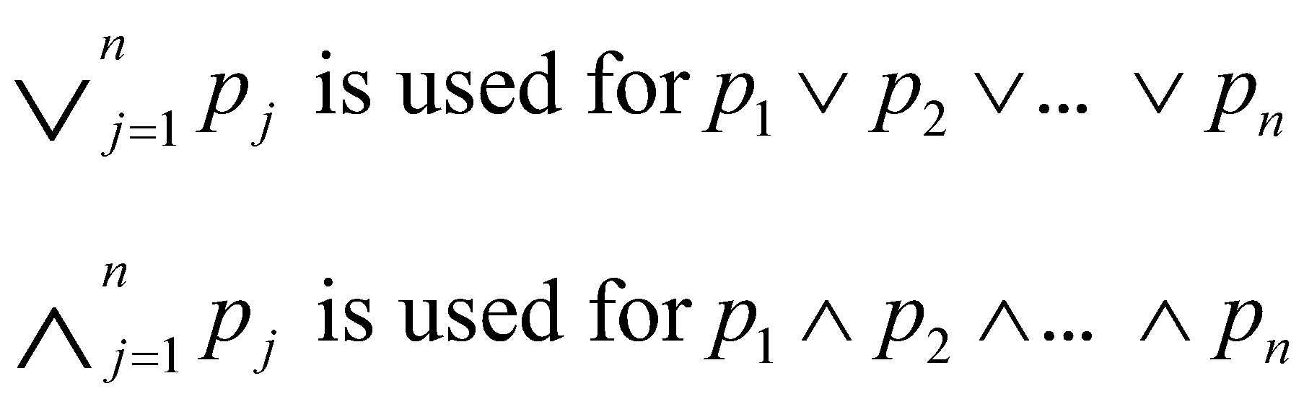
Notation
Needed for the next example.

Slide 59
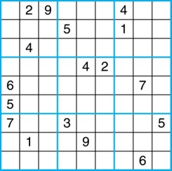
Sudoku
A Sudoku puzzle is represented by a 9×9 grid made up of nine 3×3 subgrids, known as blocks. Some of the 81 cells of the puzzle are assigned one of the numbers 1,2, …, 9.
The puzzle is solved by assigning numbers to each blank cell so that every row, column and block contains each of the nine possible numbers.
Example

Slide 60
Encoding as a Satisfiability Problem 1
Let p(i,j,n) denote the proposition that is true when the number n is in the cell in the ith row and the jth column.
There are 9 × 9 × 9 = 729 such propositions.
In the sample puzzle p(5,1,6) is true, but p(5,j,6) is false for j = 2,3,…9

Slide 61
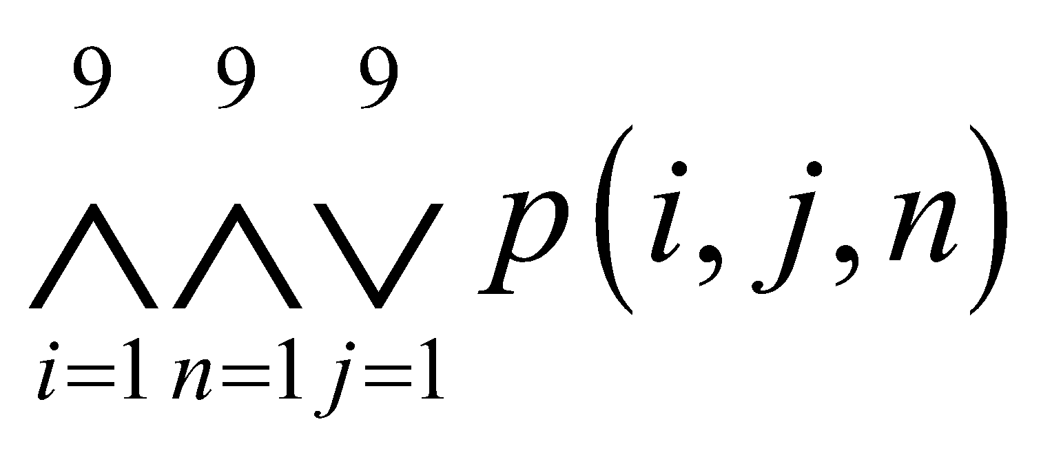
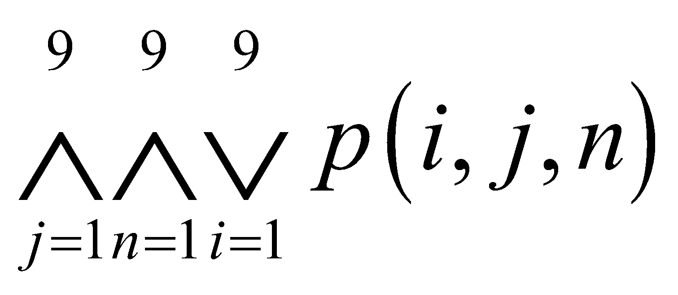
Encoding as a Satisfiability Problem 2
For each cell with a given value, assert p(i,j,n), when the cell in row i and column j has the given value.
Assert that every row contains every number.
Assert that every column contains every number.

Slide 62
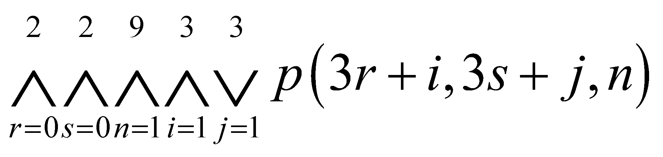
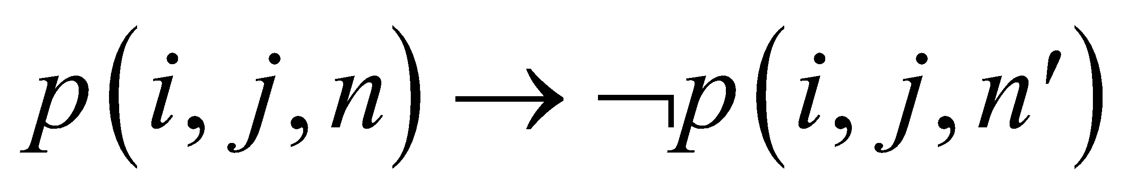
Encoding as a Satisfiability Problem 3
Assert that each of the 3 × 3 blocks contain every number.
(this is tricky - ideas from chapter 4 help)
Assert that no cell contains more than one number. Take the conjunction over all values of n, n’, i, and j, where each variable ranges from 1 to 9 and n ≠ n’ , of

Slide 63
Solving Satisfiability Problems
To solve a Sudoku puzzle, we need to find an assignment of truth values to the 729 variables of the form p(i,j,n) that makes the conjunction of the assertions true. Those variables that are assigned T yield a solution to the puzzle.
A truth table can always be used to determine the satisfiability of a compound proposition. But this is too complex even for modern computers for large problems.
There has been much work on developing efficient methods for solving satisfiability problems as many practical problems can be translated into satisfiability problems.

